Slide 1
자율주행이동체 실제
(6. AUTOSAR)
충북대학교 지능로봇공학과
기석철 교수
sckee@cbnu.ac.kr, E8-7동 341-1호

Slide 2
Contents
Autosar Overview
Autosar Architecture
Autosar Applications

Slide 3
What is Autosar
AUTOSAR – AUTomotive Open Systems ARchitecture
  Definition: Middleware and system-level standard, jointly developed by automobile manufacturers, electronics and software suppliers and tool vendors.
  Scale: More than 100 members
  Motto: “cooperate on standards, compete on implementations”
  Reality: current struggle between OEM and Tier1 suppliers
  Target: facilitate portability, composability, integration of SW components over the lifetime of the vehicle

Slide 4
Standard of Components and Interface
The software implementing the automotive functionality is encapsulated in software components. Standardization of the interfaces is central to support scalability and transferability of functions. Any standard-conformant implementation of a software component can be integrated with substantially reduced effort in a system.
The standardization could be developed incrementally towards:
  Level of abstraction
    Functional aspects
    Behavior and implementation aspects
  Level of decomposition
    Low degree of decomposition of the functional domain
    High degree of decomposition of the functional domain
  Level of architecture definition
    Terminology
    Standardized data-types
    Partial description of interfaces (without semantics)
    Complete description of interfaces (without semantics)
    Complete description of interfaces (with semantics)
    Partial definition of the functional domain
    Complete definition of the functional domain

Slide 5
Functional Domains
The specification of functional interfaces is divided into 6 domains:
  Body/Comfort
  Powertrain
  Chassis
  Safety
  Multimedia/Telematics
  Man-machine-interface
The domains could be differently handled due to intellectual property rights issues and decomposition levels.
In the first phase of AUTOSAR only in the domains body/comfort, chassis, and powertrain results can be expected. All others have lower priority in the first phase.

Slide 6
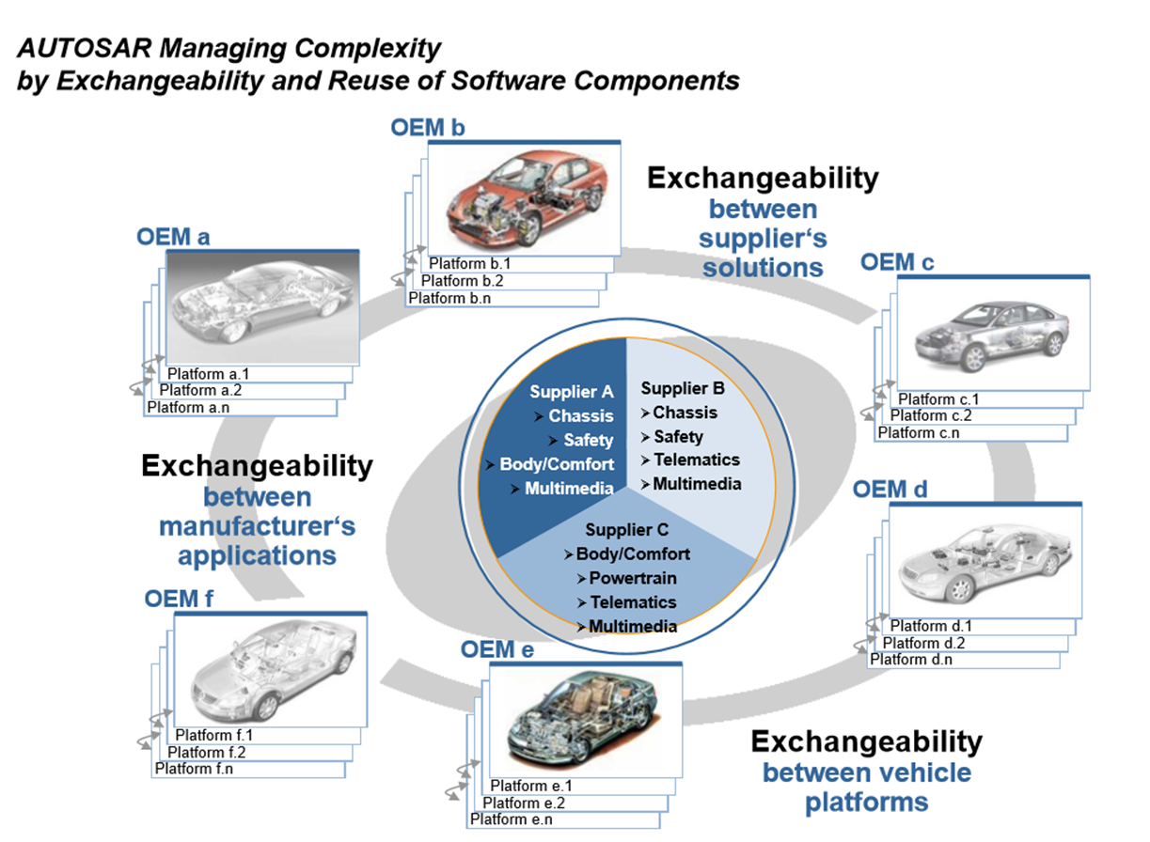
Industrial Background

Slide 7
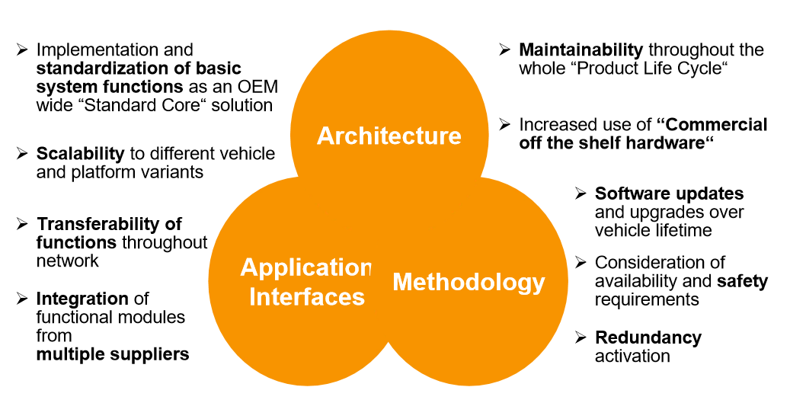
Main Topic

Slide 8
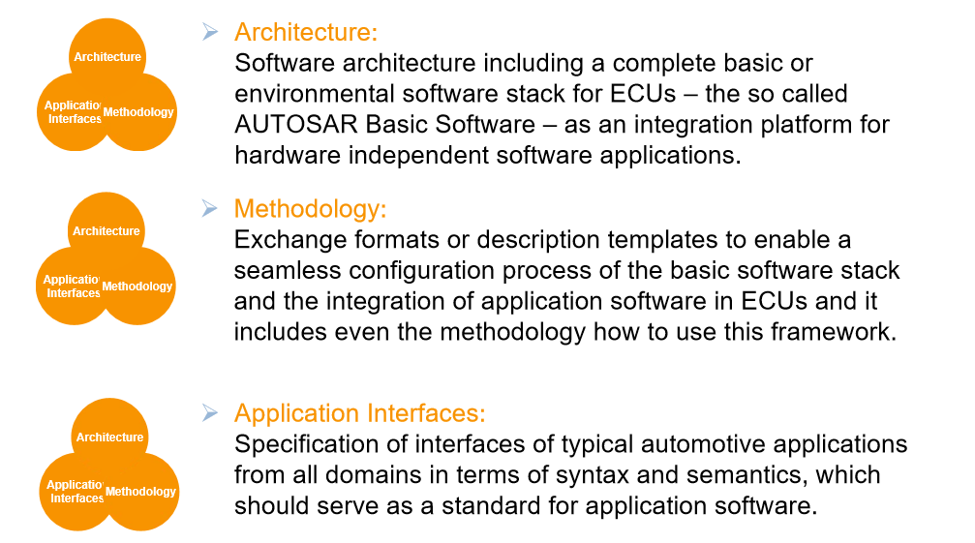
Main Topic

Slide 9
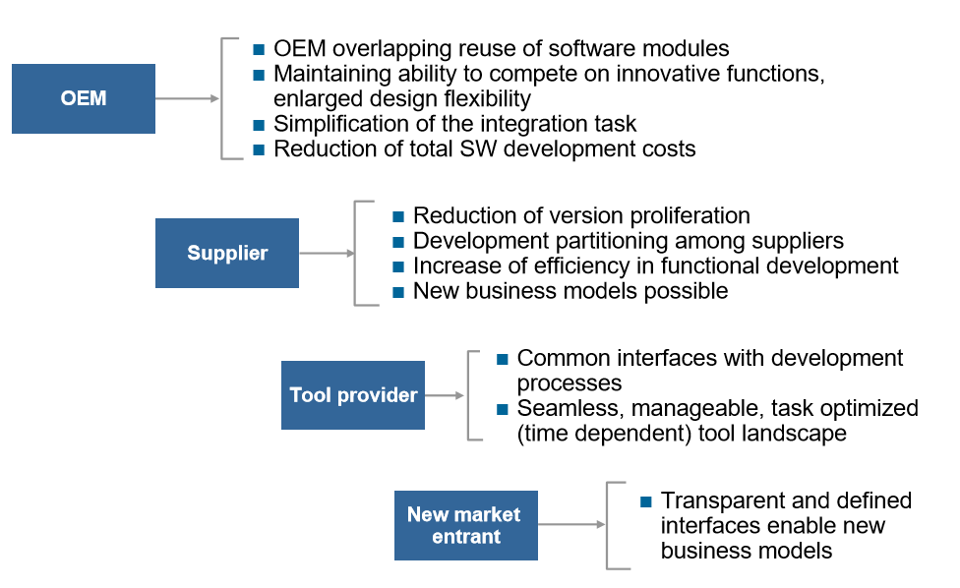
Benefits for industry

Slide 10
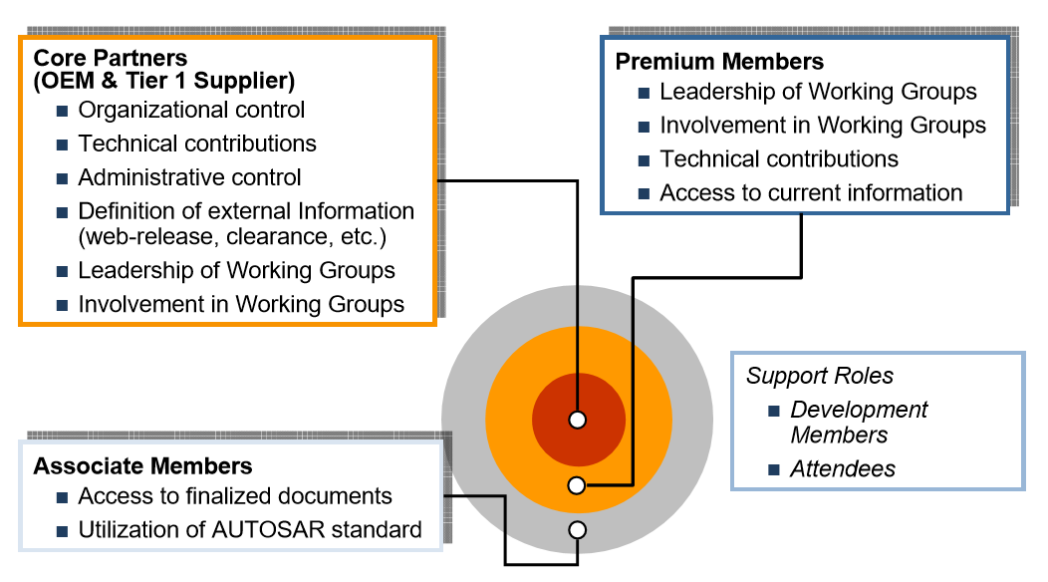
Partnership Structure

Slide 11
Core partners and members
Up-to-date status see: http://www.autosar.org, 2024년 4월까지 350+ 기관 가입

Slide 12
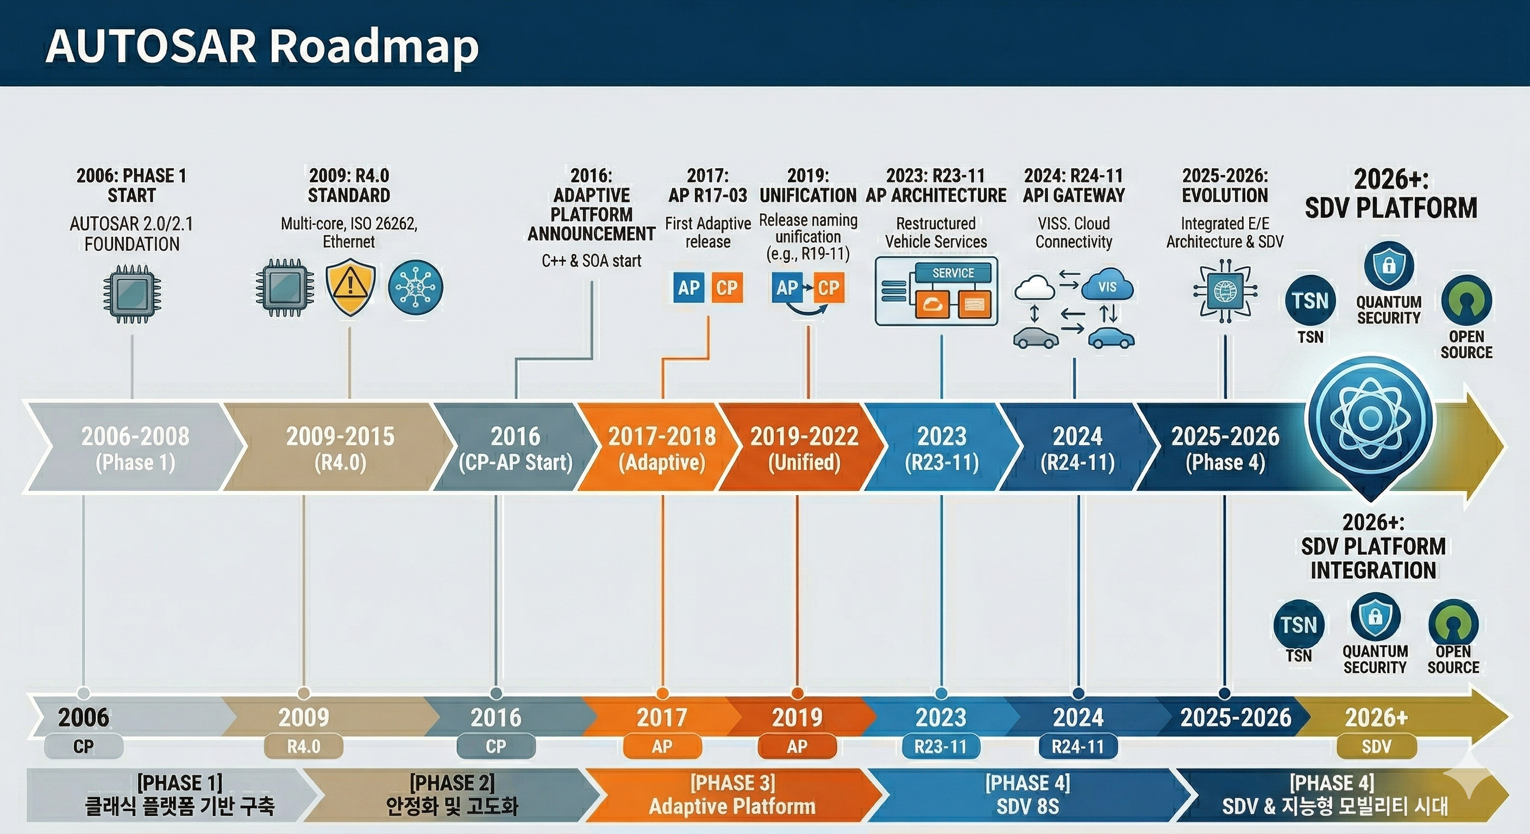
8-Layer SDV Stack

Slide 13
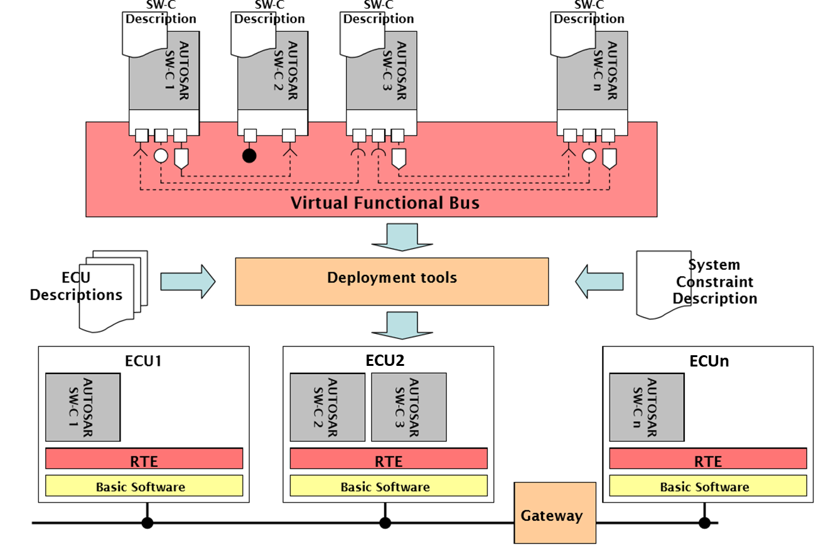
Architecture

Slide 14
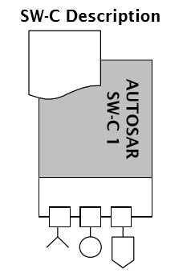
Software Component
The AUTOSAR Software Components encapsulate an application which runs on the AUTOSAR infrastructure. The AUTOSAR SW-C have well-defined interfaces, which are described and standardized.
  SW-C Description
    For the interfaces as well as other aspects needed for the integration of the AUTOSAR Software Components, AUTOSAR provides a standard description format (SW-C Description).

Slide 15
Virtual Functional Bus(VFB)
The “virtual functional bus” is the communication mechanism that allows these components to interact.
In a design step called “Configure System”, the components are mapped on specific system resources (ECUs). Thereby, the virtual connections between the components are mapped onto local connections (within a single ECU) or on network-technology specific communication mechanisms (such as CAN or FlexRay frames).
Finally, the individual ECUs in such a system can be configured.
The concrete interface between the individual components and between the components and the Basic Software (BSW) is called the Run-Time Environment (RTE).
The VFB specification needs to provide concepts for all infrastructure-services that are needed by a component implementing an automotive application. These include:
  Communication to other components in the system
  Communication to sensors and actuators in the system
  Access to standardized services, such as reading to or writing from non-volatile ram
  Responding to mode-changes, such as changes in the power-status of the local ECU
  Interacting with calibration and measurement systems

Slide 16
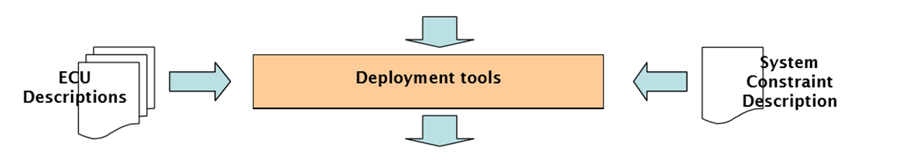
ECU Descriptions
In order to integrate AUTOSAR SW-Components into a network of ECUs, AUTOSAR provides description formats for the system as well as for the resources and the configuration of the ECUs.

Slide 17
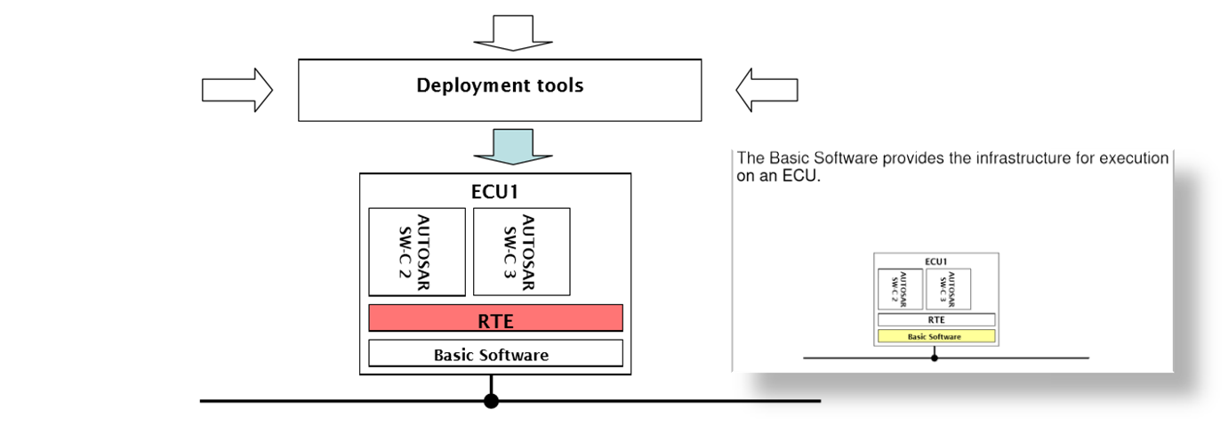
Mapping on EUCs
AUTOSAR defines the methodology and tool support to build a concrete system of ECUs. This includes the configuration and generation of the Runtime Environment (RTE) and the Basic Software (RTOS) on each ECU.
  Runtime Environment (RTE)
    From the viewpoint of the AUTOSAR Software Component, the RTE implements the VFB functionality on a specific ECU.

Slide 18
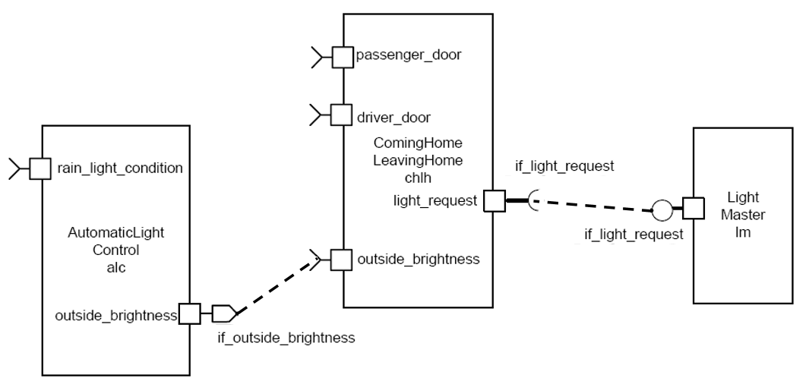
Architecture
Core Concept of AUTOSAR
A fundamental concept of AUTOSAR is the separation between:
  application and
  infrastructure.
An application in AUTOSAR consists of Software Components interconnected by connectors.

Slide 19
Architecture
The generic “AUTOSAR Component” concept
  AUTOSAR Software Component
  Sensor/Actuator Software Component (special case)
  Composition
    A logical interconnection of components packaged as a component. In contrast to the Atomic Software Components, the components inside a composition can be distributed over several ECUs.
  ECU Abstraction
  Complex Device Driver
  AUTOSAR Services

Slide 20
Software Component
Each AUTOSAR Software Component encapsulates part of the functionality of the application.
  AUTOSAR does not prescribe the granularity of Software Components. Depending on the requirements of the application domain an AUTOSAR Software Component might be a small, reusable piece of functionality (such as a filter) or a larger block encapsulating an entire subsystem.
The AUTOSAR Software Component is an "Atomic Software Component"
  Atomic means that the each instance of an AUTOSAR Software Component is statically assigned to one ECU.
Implementing an AUTOSAR Software Component
AUTOSAR does not prescribe HOW an AUTOSAR Software Component should be implemented
  a component may be handwritten or generated from a model

Slide 21
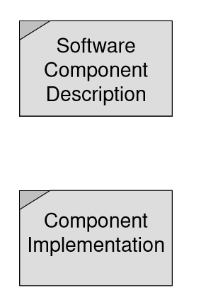
Software Component
Shipping an AUTOSAR Software Component
A shipment of an AUTOSAR Software Component consists of:
  A complete and formal Software Component Description which specifies how the infrastructure must be configured for the component, and
  An implementation of the component, which could be provided as "object code" or "source code".

Slide 22
SWC - Description
The AUTOSAR Software Component Description contains:
  the operations and data elements that the software component provides and requires
    described using the PortInterface concept
  the requirements on the infrastructure,
  the resources needed by the software component (memory, CPU-time, etc.),
  information regarding the specific implementation of the software component.
  The structure and format of this description is called “software component template”.

Slide 23
SWC - Implementation
A source code component implementation is independent from
  the type of microcontroller of the ECU and the type of ECU on which the component is mapped
    The AUTOSAR infrastructure takes care of providing the software component with a standardized view on the ECU hardware
  the location of the other components with which it interacts.
    The component description defines the data or services that it provides or requires. The component doesn’t know if they are provided from components on the same ECU or from components on a different ECU.
  the number of times a software component is instantiated in a system or within one ECU

Slide 24
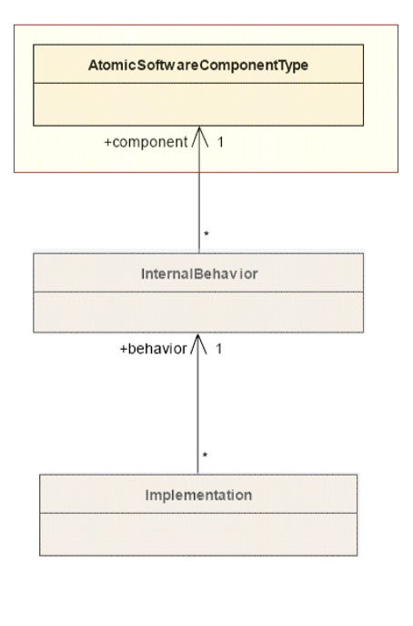
SWC – Description level
The highest (most abstract) description level is the Virtual Functional Bus.
Here components are described with the means of datatypes and interfaces, ports and connections between them, as well as hierarchical components. At this level, the fundamental communication properties of components and their communication relationships among each other are expressed.
  Software components
  Compositions
  Interfaces

Slide 25
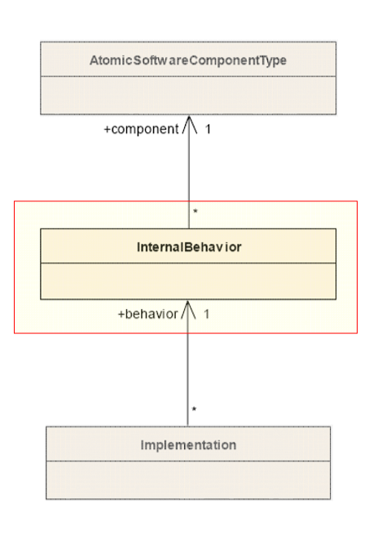
SWC – Description level
Description of components on RTE level
The middle level allows for behavior description of a given component. This behavior is expressed through RTE concepts, e.g. RTE events and in terms of schedulable units(Runnables).
For instance, for an operation defined in an interface on the VFB, the behavior specifies which of those units is activated as a consequence of the invocation of that operation.
  Runnables
  Events
  Interaction with the Run Time Environment

Slide 26
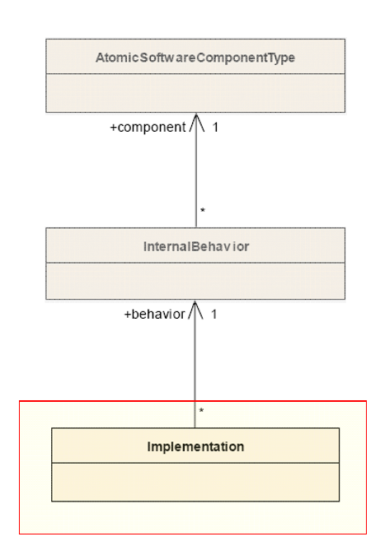
SWC – Description level
Descriptions of components on implementation level
The lowest (most concrete) level of description specifies the implementation of a given behavior. More precisely, the schedulable units of such a behavior are mapped to code.
The two layers above constrain the RTE API that a component is offered, the implementation now utilizes this API.
  Component implementation
  Resource consumption of SW-Components

Slide 27
Components, Ports, Interfaces
A component has well-defined ports, through which the component can interact with other components.
A port always belongs to exactly one component and represents a point of interaction between a component and other components.
To define the services or data that are provided on or required by a port of a component, the AUTOSAR Interface concept is introduced.
The AUTOSAR Interface can be:
  Client-Server Interface defining a set of operations that can be invoked
  Sender-Receiver Interface, for data-oriented communication

Slide 28
Components, Ports, Interfaces
A port can be
  PPort (provided interface)
  RPort (required interface)
When a PPort provides an interface, the component to which the port belongs
  provides an implementation of the operations defined in the Client-Server Interface
  generates the data described in a data-oriented Sender-Receiver Interface.
When an RPort of a component requires an AUTOSAR Interface, the component can
  invoke the operations when the interface is a Client-Server
  read the data elements described in the Sender-Receiver Interface.

Slide 29
Communication Patterns
Elementary Communication Patterns
  Client-Server
  Sender-Receiver
Interfaces specify
  which services with which arguments can be called by client-server communication
  what information sender receiver communication transports
The formal description of the interface is in the software component template, including also data types that can be used and interface compatibility.
The detailed behavior of a basic communication pattern is specified by attributes. With those attributes e.g. the length of data queues and the behavior of receivers (blocking, non-blocking, etc.) and senders (send cyclic, etc.) can be defined.

Slide 30
Client - Server
The server is a provider and the client is a user of a service.
The client initiates the communication, requesting that the server performs a service, transferring a parameter set if necessary. The server waits for incoming communication requests from a client, performs the requested service and dispatches a response to the client’s request.
The direction of initiation is used to categorize whether an AUTOSAR Software Component is a client or a server. A single component can be both a client and a server depending on the software realization.
After the service request is initiated and until the response of the server is received The client can be:
  blocked (synchronous communication)
  non-blocked (asynchronous communication).

Slide 31
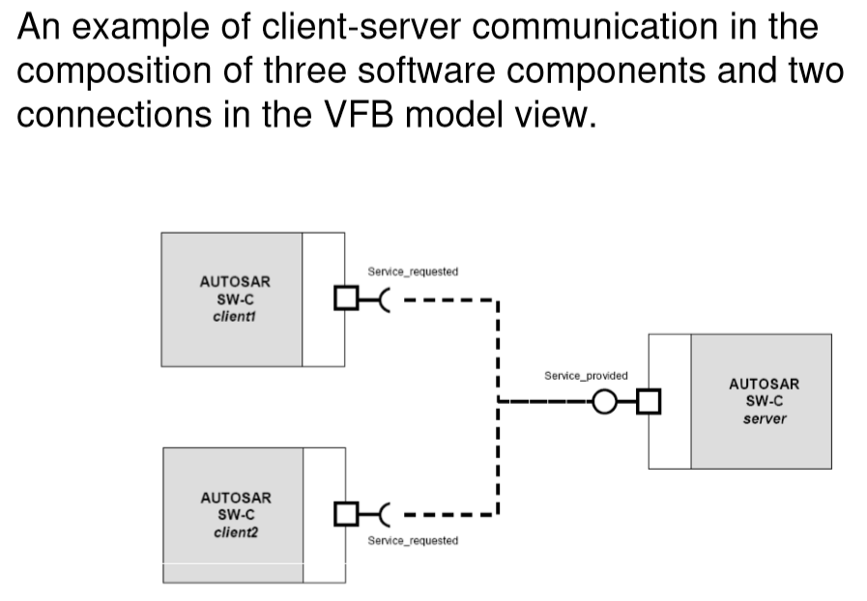
Client - Server

Slide 32
Sender - Receiver
Model for the asynchronous distribution of information where a sender distributes information to one or several receivers.
The sender is not blocked (asynchronous communication) and neither expects nor gets a response from the receivers (data or control flow), the sender just provides the information and the receivers decides autonomously when and how to use it.
It is the responsibility of the communication infrastructure to distribute the information.
The sender does not know the identity or the number of receivers.

Slide 33
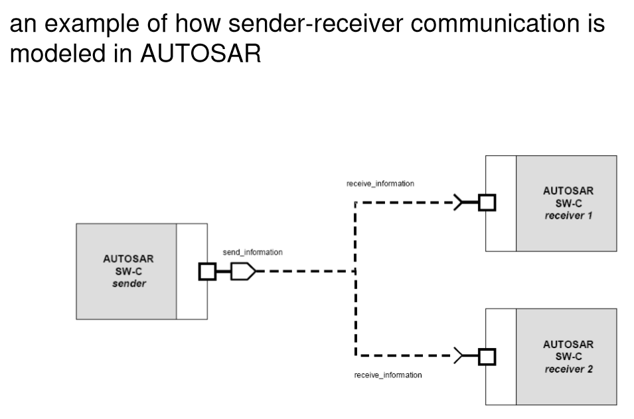
Sender - Receiver

Slide 34
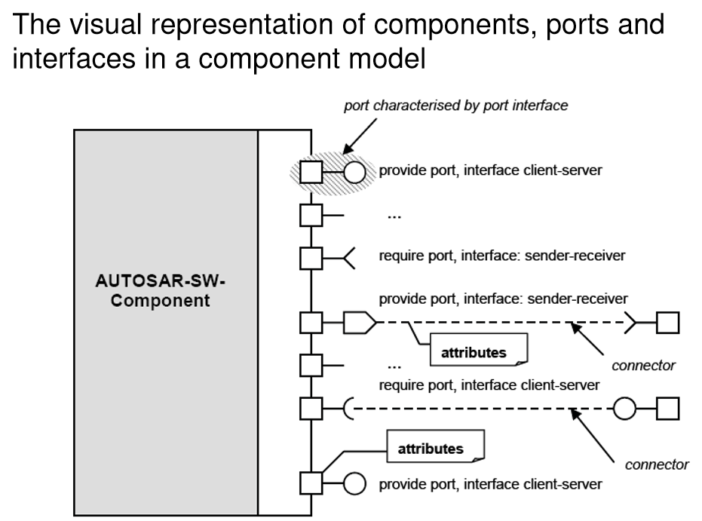
Component Model

Slide 35
Communication via the Virtual Functional Bus
AUTOSAR software components communicate via the Virtual Functional Bus. They need ways to express requirements and capabilities with respect to exchanging data, which is currently possible through two kinds of attributes:
  Communication attributes, allow specifying parameters of the communication that affect the generation of the RTE or the actual communication taking place at runtime. An example for such an attribute is the aforementioned transfer time over a connector.
  Application level attributes, allow describing properties of exchanged data that do not affect the RTE generation, but are indicate to the developer how data needs to be processed. An example for this kind of attribute is a flag, whether data is “filtered” or “raw”.

Slide 36
Sensor/Actuator Components
Sensor/Actuator Components are special AUTOSAR Software Components which encapsulate the dependencies of the application on specific sensors or actuators.
The AUTOSAR infrastructure takes care of hiding the specifics of the microcontroller (this is done in the MCAL, the microcontroller abstraction layer, which is part of the AUTOSAR infrastructure running on the ECU) and the ECU electronics (this is handled by the ECU-Abstraction which is also part of the AUTOSAR Basic Software).
The AUTOSAR infrastructure does NOT hide the specifics of sensors and actuators.
The dependencies on a specific sensor and/or actuator are dealt with in "Sensor/Actuator Software Component", which is a special kind of Software Component. Such a component is independent of the ECU on which it is mapped but is dependent on a specific sensor and/or actuator for which it is designed.
  For example, a "Sensor Component" typically inputs a software representation of the electrical signal at an input-pin of the ECU (e.g. a current produced by the sensor) and outputs the physical quantity measured by the sensor (e.g. the car speed).
Typically, because of performance issues, such components will need to run on the ECU to which the sensor/actuator is physically connected.

Slide 37
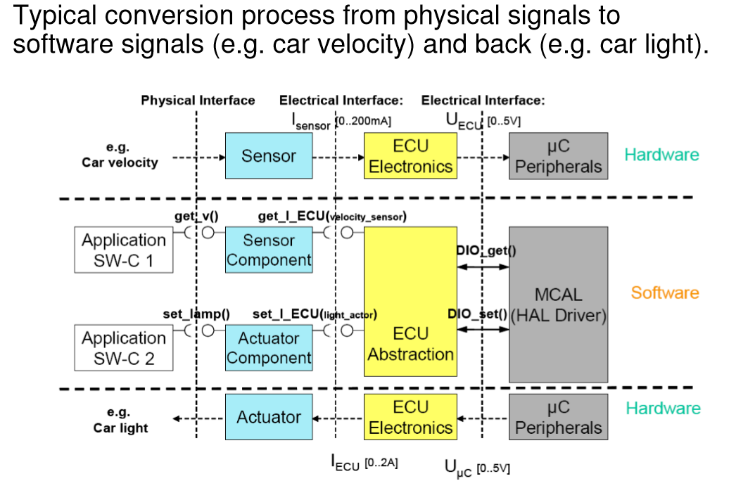
Sensor/Actuator Components

Slide 38
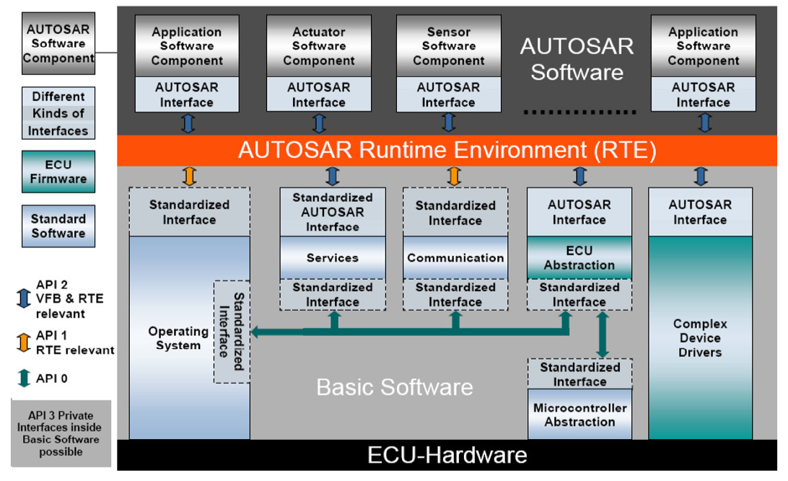
ECU SW Architecture

Slide 39
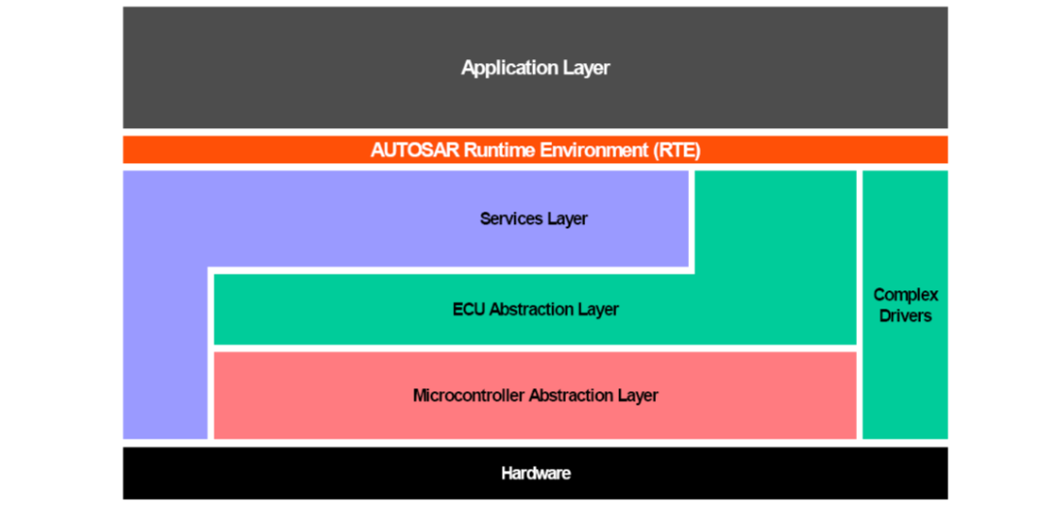
Layered SW Architecture
A layered architecture has been developed within AUTOSAR to enable a clear and structured interface definition and a well defined abstraction of the hardware.
The architecture is structured in 5 layers plus the Complex Drivers.

Slide 40
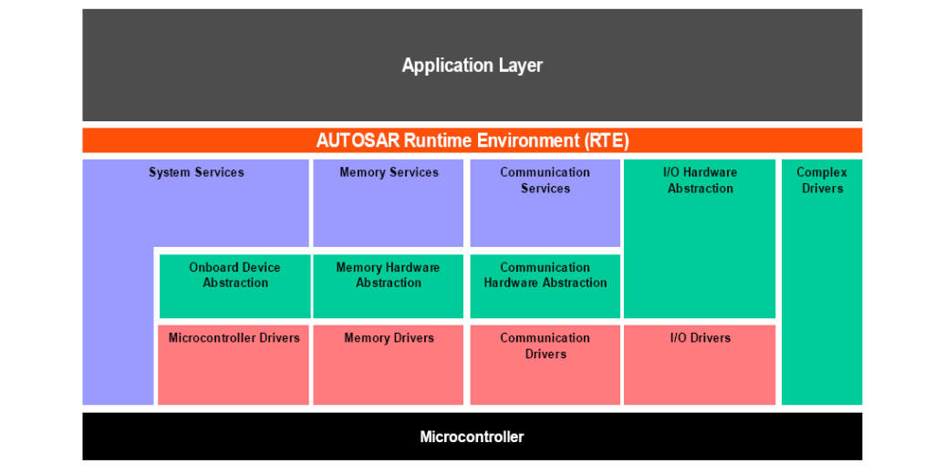
Basic SW Architecture
Refined Layered Architecture (Basic Software)
The layered architecture has been further refined in the area of Basic Software. Around 80 Basic Software modules have been defined (11 main blocks plus Complex Drivers).

Slide 41
Microcontroller Abstraction Layer(MCAL)
Access to the microcontroller registers is routed through the Microcontroller Abstraction Layer (MCAL).
MCAL is a hardware specific layer that ensures a standard interface to the Basic Software. It manages the microcontroller peripherals and provides the components of the Basic Software with microcontroller independent values. MCAL implements notification mechanisms to support the distribution of commands, responses and information to processes.
It can include:
  Digital I/O (DIO)
  Analog/Digital Converter (ADC)
  Pulse Width (De)Modulator (PWM, PWD)
  EEPROM (EEP)
  Flash (FLS)
  Capture Compare Unit (CCU)
  Watchdog Timer (WDT)
  Serial Peripheral Interface (SPI)
  I2C Bus (IIC)

Slide 42
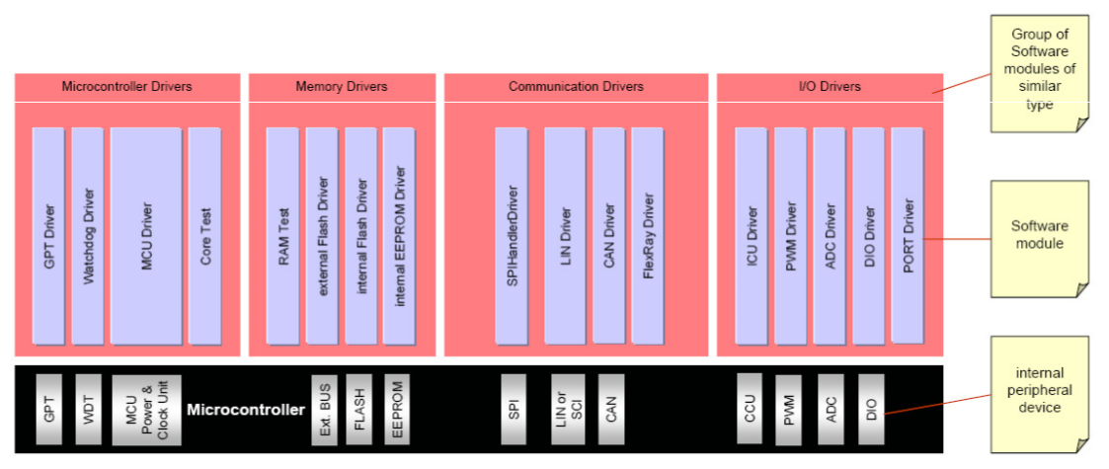
Microcontroller Abstraction Layer(MCAL)
The Microcontroller Abstraction Layer is the lowest layer of the Basic Software. It contains drivers, with direct access to the micro-Computer internal peripherals and memory mapped micro-Computer external devices.

Slide 43
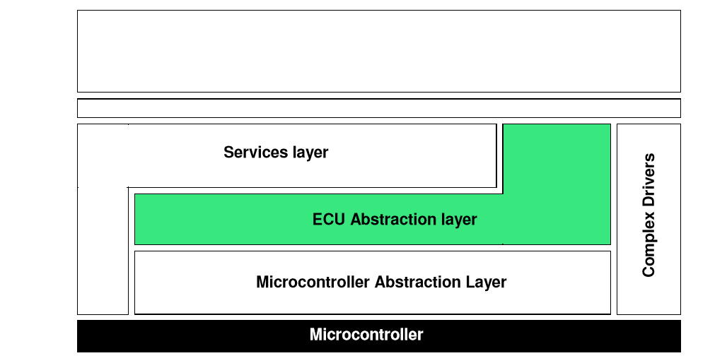
ECU Abstraction Layer
The ECU Abstraction Layer provides a software interface to the electrical values of any specific ECU in order to decouple higher-level software from all underlying hardware dependencies.

Slide 44
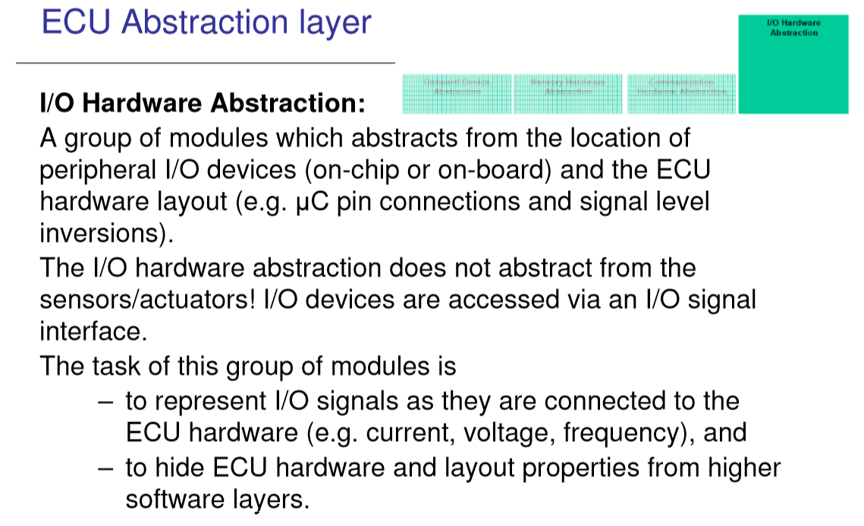
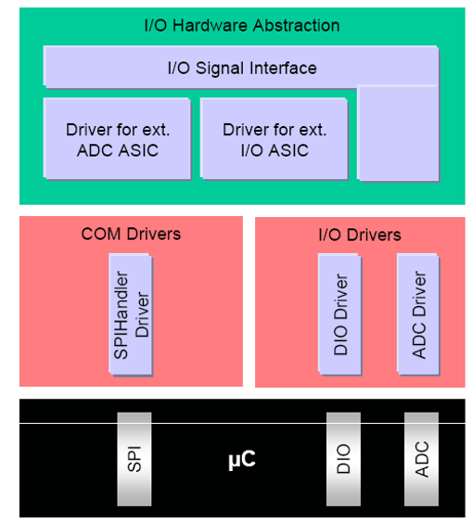
ECU Abstraction Layer

Slide 45
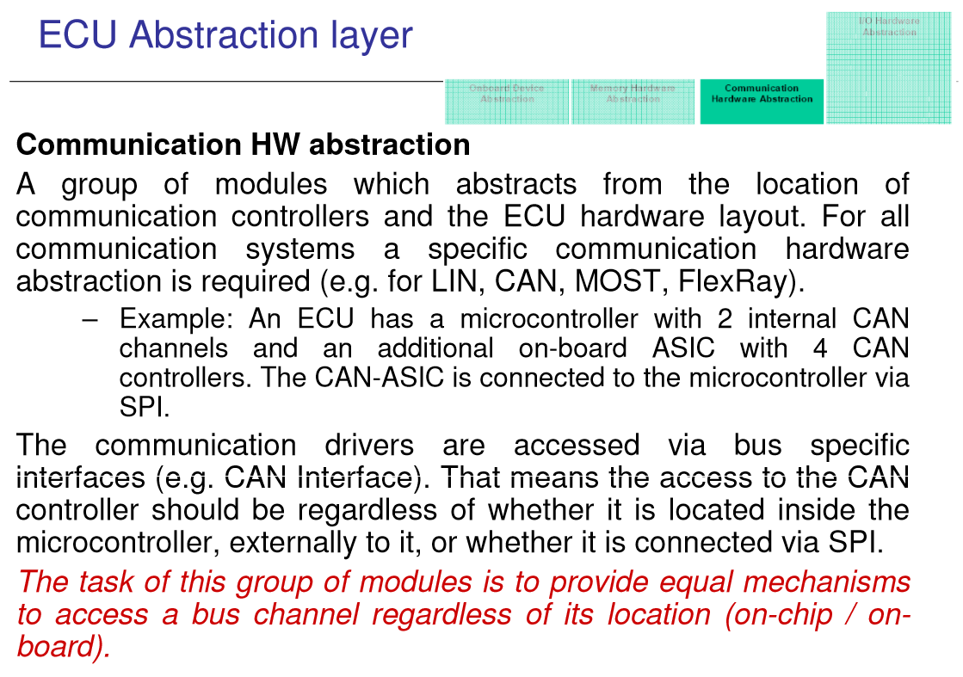
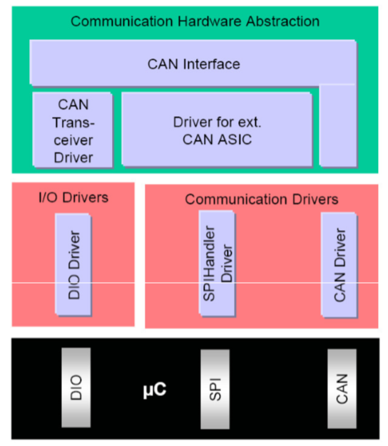
ECU Abstraction Layer

Slide 46
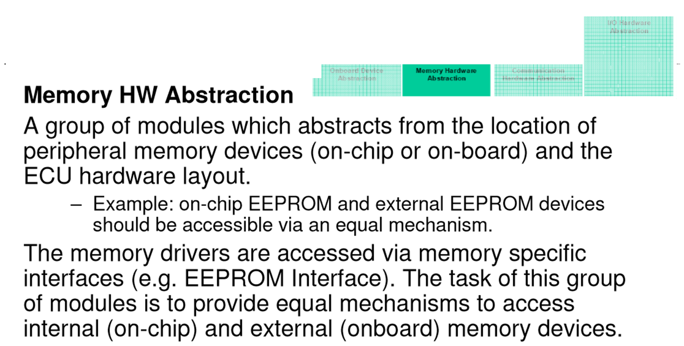
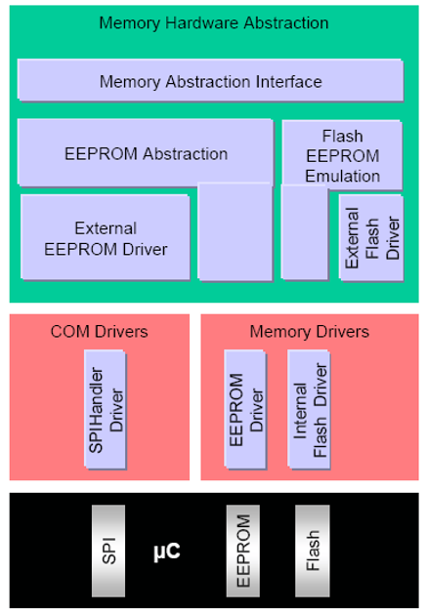
ECU Abstraction Layer

Slide 47
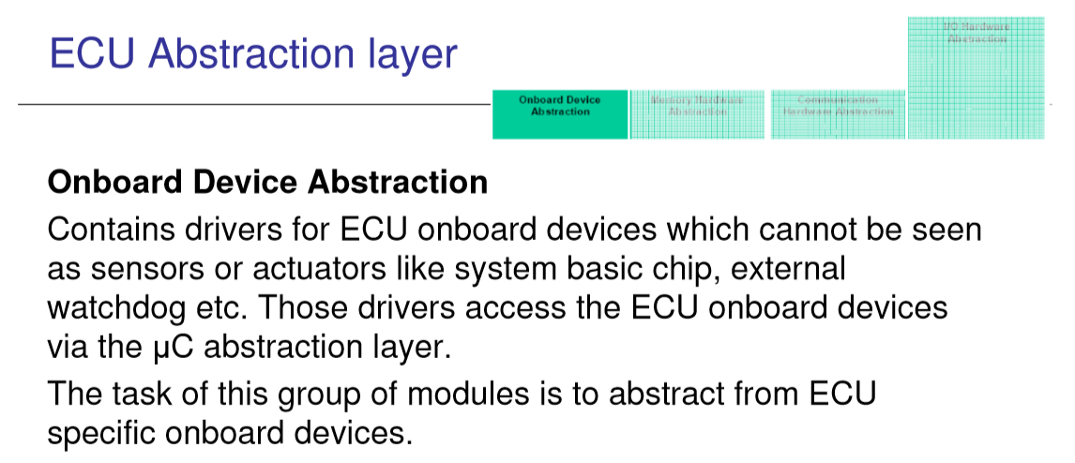
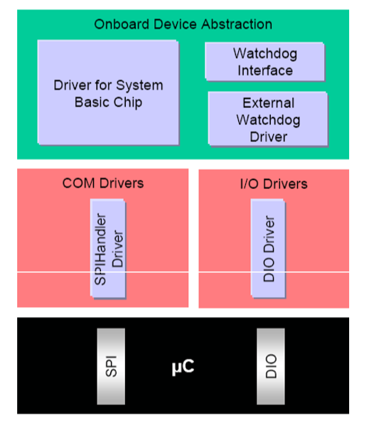
ECU Abstraction Layer

Slide 48
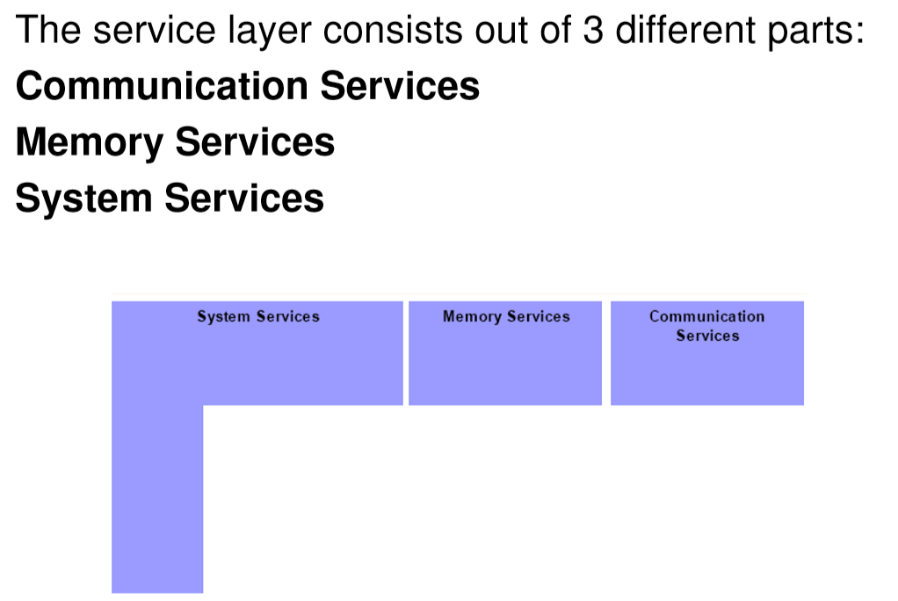
Service Layer

Slide 49

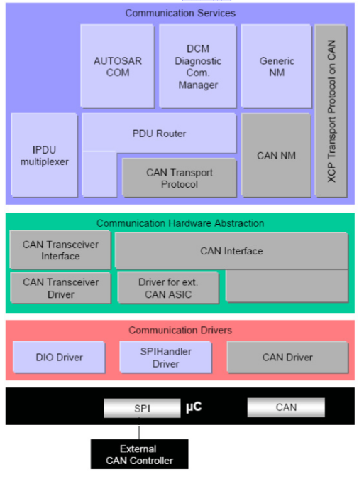
Service Layer – Communication
The communication services are a group of modules for vehicle network communication (CAN, LIN, FlexRay and MOST). They are interfacing with the communication drivers via the communication hardware abstraction.
The task of this group of modules is:
  to provide a uniform interface to the vehicle network for communication between different applications,
  to provide uniform services for network management,
  to provide a uniform interface to the vehicle network for diagnostic communication, and
  to hide protocol and message properties from the application.

Slide 50
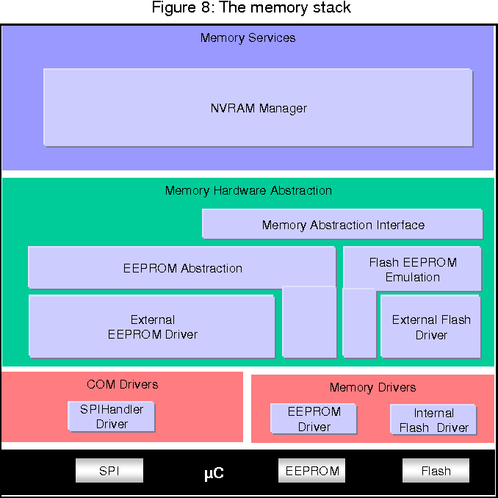
Service Layer – Memory
A group of modules responsible for the management of non-volatile data (read/write from different memory drivers). The NVRAM manager provides a RAM mirror as data interface to the application for fast read access.
The task of this group of modules is:
  to provide non-volatile data to the application in a uniform way,
  to abstract from memory locations and properties, and
  to provide mechanisms for non-volatile data management like saving, loading, checksum protection and verification, reliable storage etc.

Slide 51
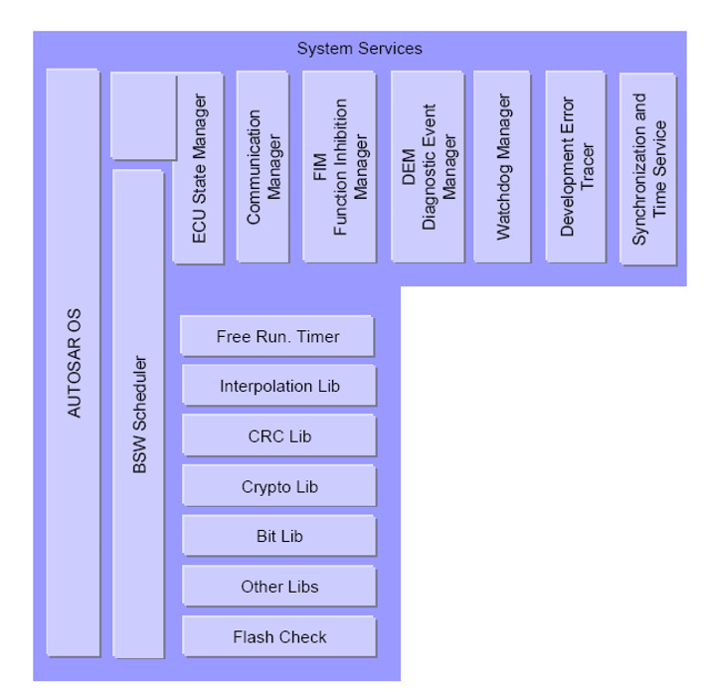
Service Layer – System
The system services are a group of modules and functions which can be used by modules of all layers.
Examples are real-time operating system, error manager and library functions (like CRC, interpolation etc.).
Some of these services are:
  Micro-Computer dependent (like OS),
  ECU hardware and/or application dependent (like ECU state manager, DCM),
  or hardware and Micro-Computer independent.
The task of this group of modules is to provide basic services for application and Basic Software modules.

Slide 52
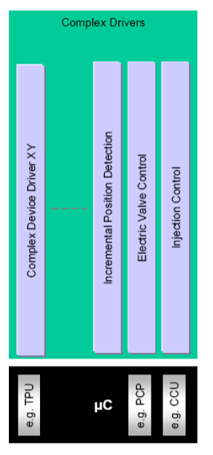
Complex Driver
The Complex Device Driver is a loosely coupled container, where specific software implementations can be placed. The only requirement to the software parts is that the interface to the AUTOSAR world has to be implemented according to the AUTOSAR port and interface specifications.
Complex Sensor and Actuator Control
The main task of the complex drivers is to implement complex sensor evaluation and actuator control with direct access to the micro-Computer using specific interrupts and/or complex micro-Computer peripherals (like PCP, TPU), e.g.
  injection control
  electric valve control
  incremental position detection

Slide 53
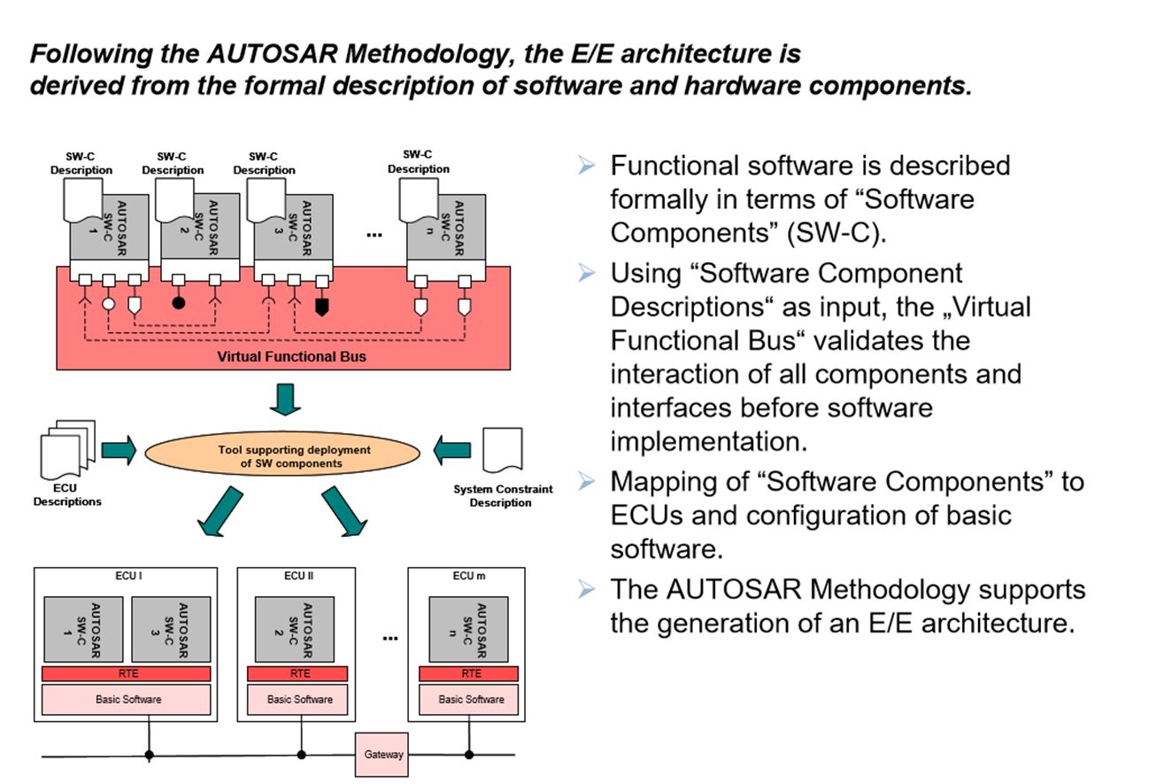
Overall Methodology

Slide 54
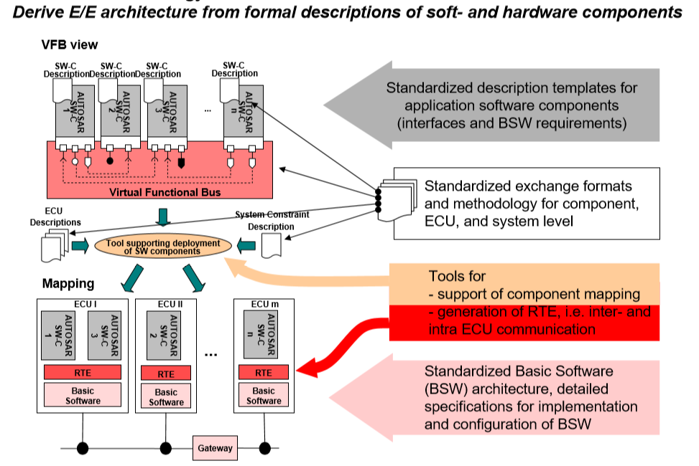
Overall Methodology

Slide 55
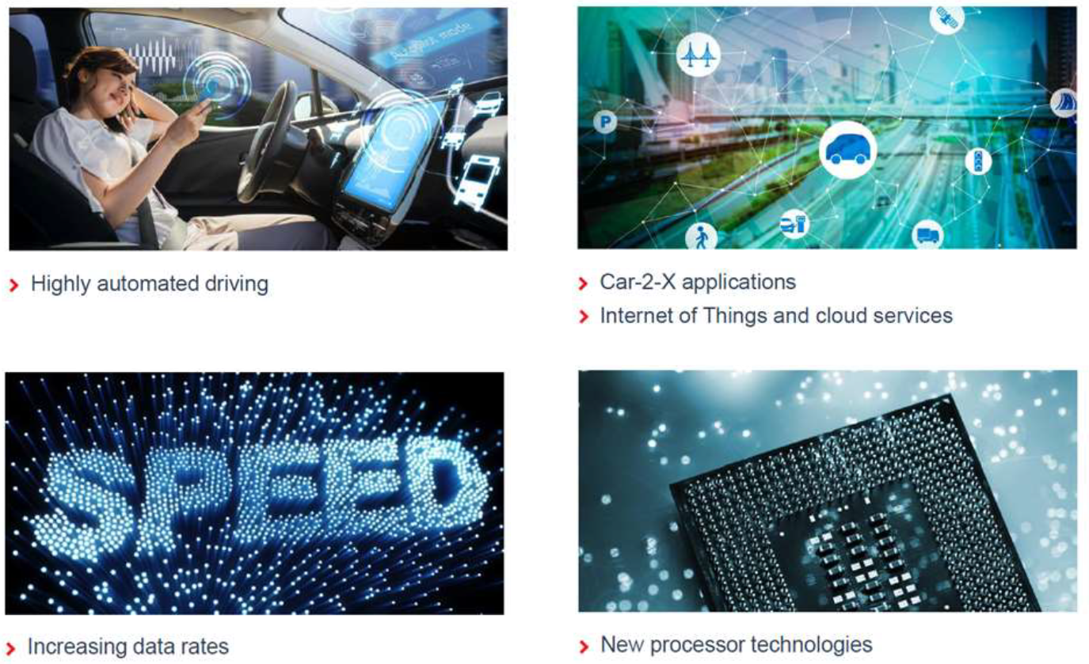
Game changer for Autosar

Slide 56
Autosar Adaptive
The AUTOSAR Adaptive Platform implements the AUTOSAR Runtime for Adaptive Applications (ARA). Two types of interfaces are available, services and APIs. The platform consists of functional clusters which are grouped in Services and the AUTOSAR Adaptive Basis.
Functional clusters...
  Assemble functionalities of the Adaptive Platform
  Define clustering of requirements specification
  Describe behavior of software platform from application and network perspective
  But do not constrain the final SW design of the architecture implementing the Adaptive Platform.
Functional clusters in AUTOSAR Adaptive Platform Basis have to have at least one instance per (virtual) machine while services may be distributed in the in-car network
In comparison to the AUTOSAR Classic Platform the AUTOSAR Runtime Environment for the Adaptive Platform dynamically links services and clients during runtime.

Slide 57
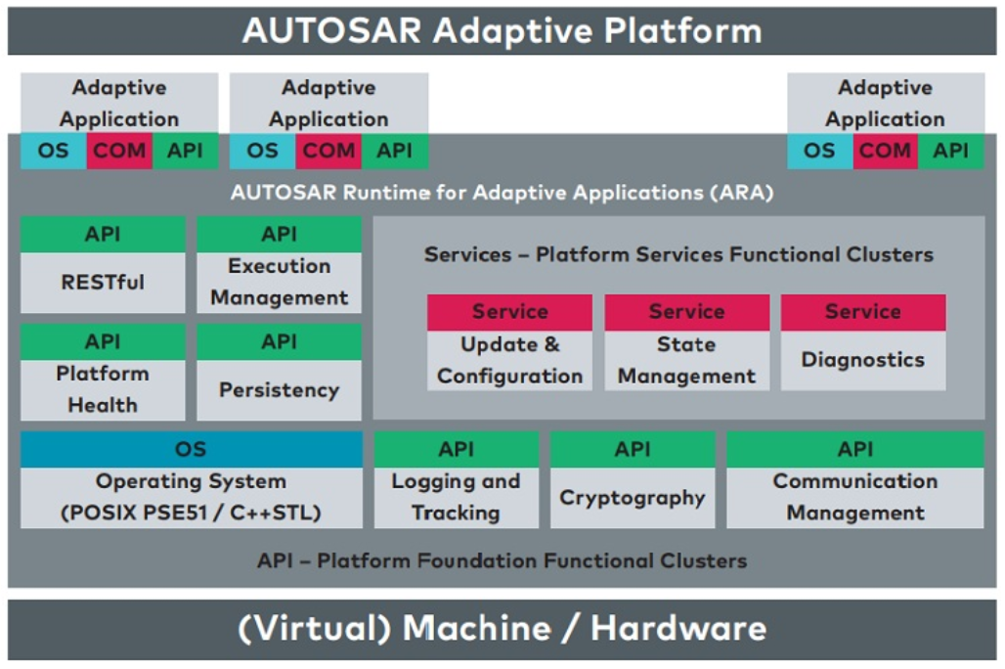
Autosar Adaptive

Slide 58
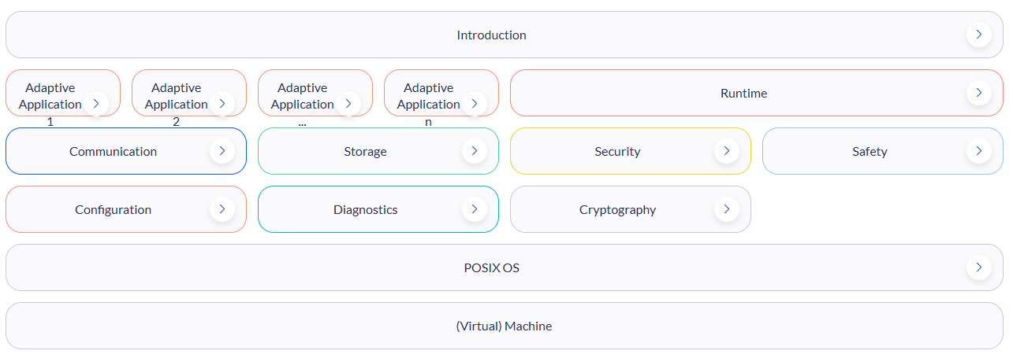
Autosar Adaptive
https://www.autosar.org/standards/adaptive-platform/
Current Release : AUTOSAR adaptive release R25-11

Slide 59
Autosar Classic vs. Adaptive
구분 | Classic Platform (CP) | Adaptive Platform (AP)
기반 OS | OSEK 기반 | POSIX 51 기반
실행 방식 | ROM 기반 실행, 단일 주소 공간, Early binding | RAM 기반 실행, 가상 주소 공간 (MMU 지원)
통신 방식 | 신호 기반 (Signal based) 통신 | 서비스 지향 (Service Oriented) 통신
주요 타겟 | Deeply embedded (임베디드 제어) | ADAS 및 자율주행 (AD)
주요 용도 | Sensors and Actuators Control | High Performance Computing
안전 등급 | 최대 ASIL-D 지원 | 최대 ASIL-B 지원
지원 언어 | C 언어 | C++ 언어
최초 릴리스 | 2004년 | 2017년 3월
표준 범위 | Specification Only | Specification and Code base
구현체 | 독자적인(Proprietary) AUTOSAR 구현 | Vector, EB 등에서 독자 제품 준비

Slide 60
Thank you for Attention
Q & A

